Slide 1
ATTITUDES CE 4200 Professional Engineering Practice Issues
Spring 2022 Semester
William D. Lawson, P.E., Ph.D.

Slide 2
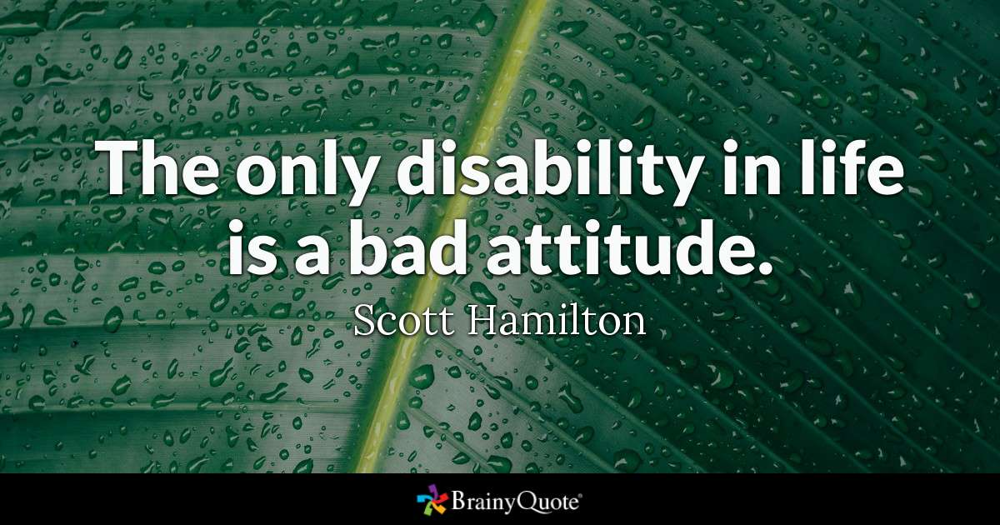
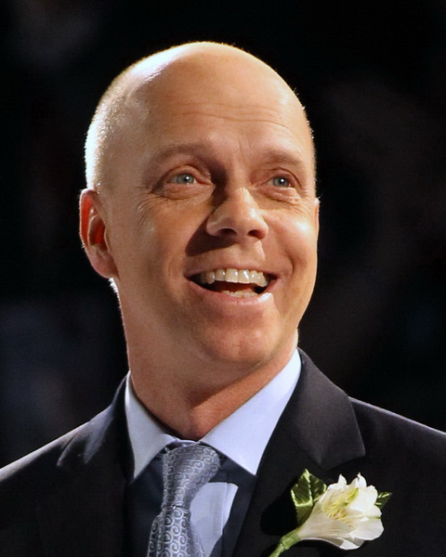

Slide 3

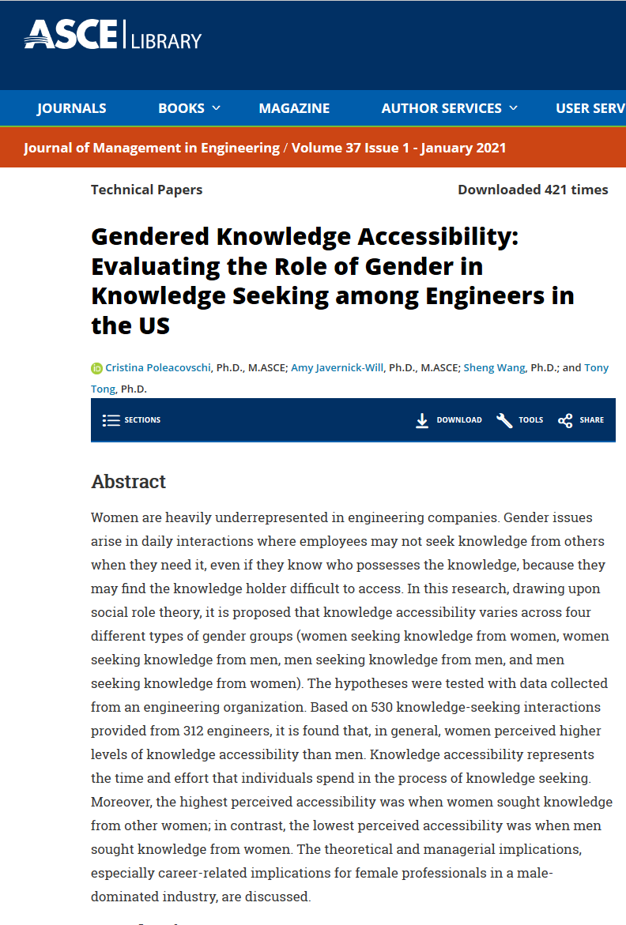
“Ripped from the headlines…”

Slide 4
ATTITUDES Professional Engineering Practice Issues
DEFINITIONS

Slide 5


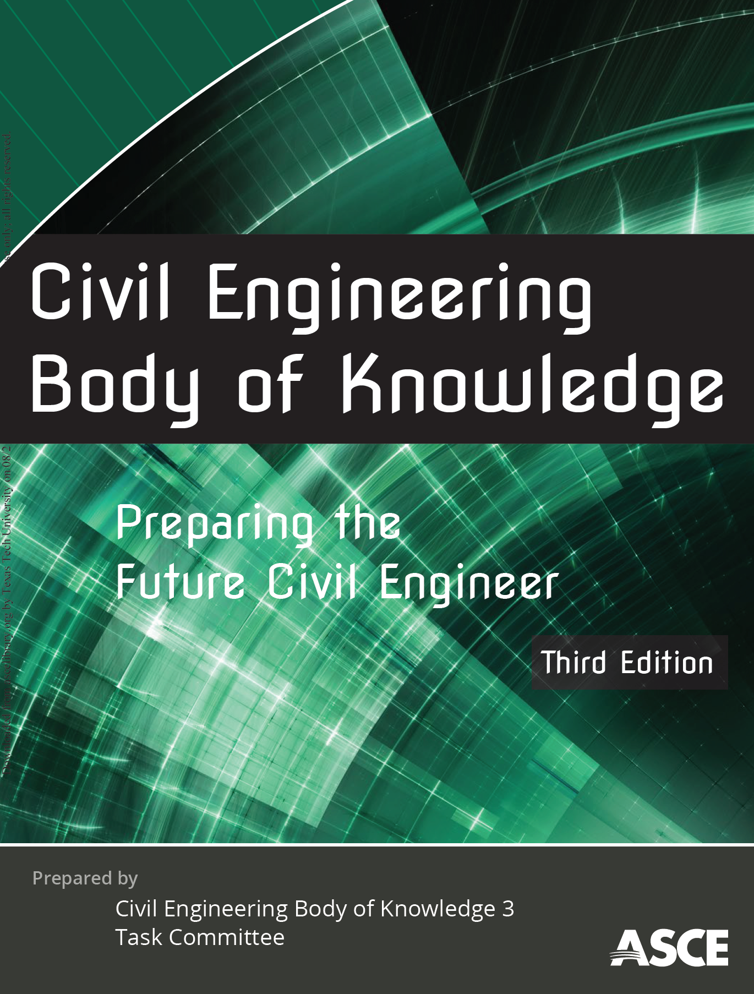
BASIC SOURCE MATERIAL FOR THESE LECTURE NOTES
BOK1 (2004)
BOK2 (2008)
BOK3 (2020)

Slide 6
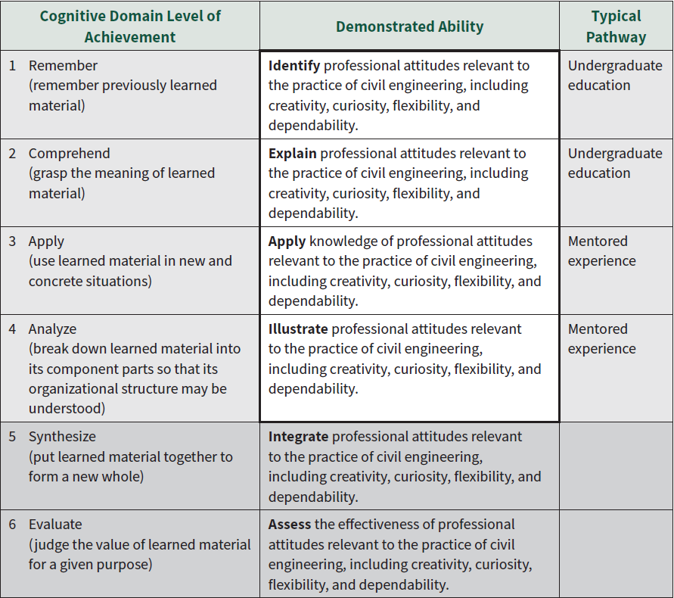
COGNITIVE LEVEL OF ACHIEVEMENT

Slide 7
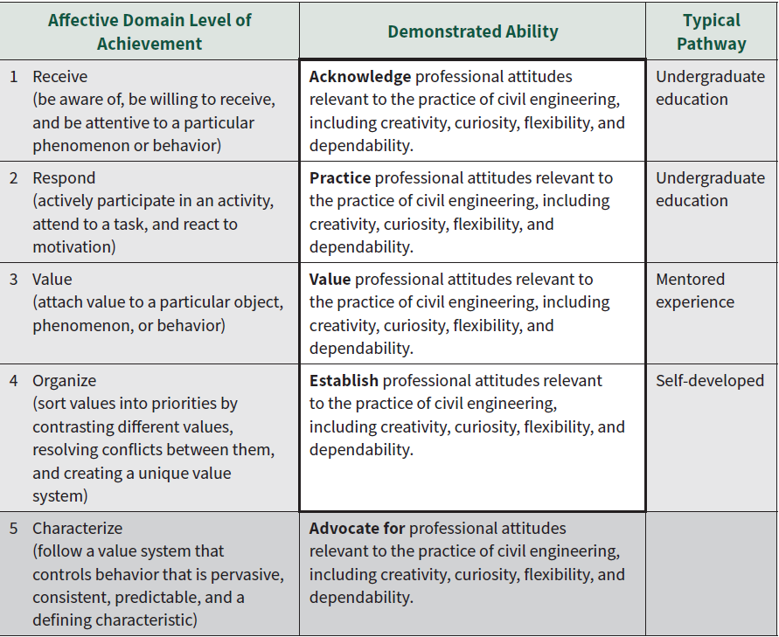
AFFECTIVE LEVEL OF ACHIEVEMENT

Slide 8

Exercise 3.1 Explore the professional attitudes of creativity, curiosity, flexibility, dependability
THINK
Identify an example of an “attitude” – positive or negative - you are personally familiar with
PAIR, SHARE…
Meet the people around you (3 to 4 persons) and discuss your ideas.
Consider how this attitude might manifest itself in engineering work. Come up with an illustration (positive or negative)
Be prepared to share your answers (5 minutes).

Slide 9
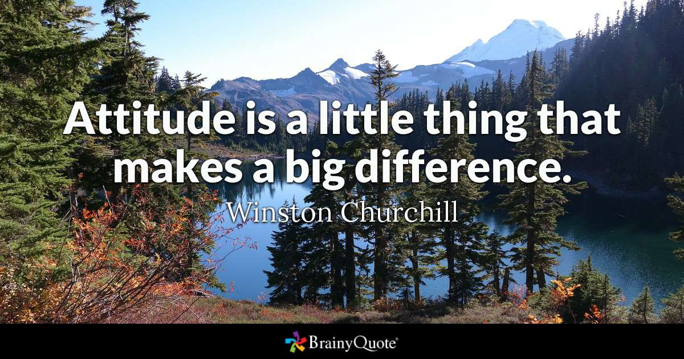
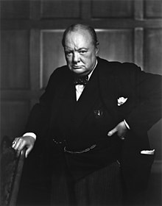

Slide 10
attitude [at-i-tood, -tyood] manner, disposition, feeling, position, etc., with regard to person or thing; tendency or orientation, especially of the mind
Synonyms
approach
belief
bias
character
demeanor
mindset
mood
notion
opinion
perspective
philosophy
point of view
position
posture
prejudice
reaction
sensibility
sentiment
stance
stand
temperament
view
Antonym… fairness
https://www.thesaurus.com/

Slide 11
DEFINITION OF “ATTITUDES”
Attitudes refer to the “ways in which one thinks and feels in response to a fact or situation.” BOK2
“Attitudes [are] learned predispositions to respond in a consistently favorable or unfavorable manner.” BOK3

Slide 12
INTENTION OF “ATTITUDES”
At the professional level, one’s attitudes will affect how knowledge and skills are applied to the solution of a civil engineering problem. BOK2
“Professional attitudes are the positive and constructive attitudes that a civil engineer should display.” BOK3
Q1. FROM WHERE DO WE GET OUR ATTITUDES?

Slide 13
ATTITUDES Professional Engineering Practice Issues
WHY ATTITUDES?

Slide 14
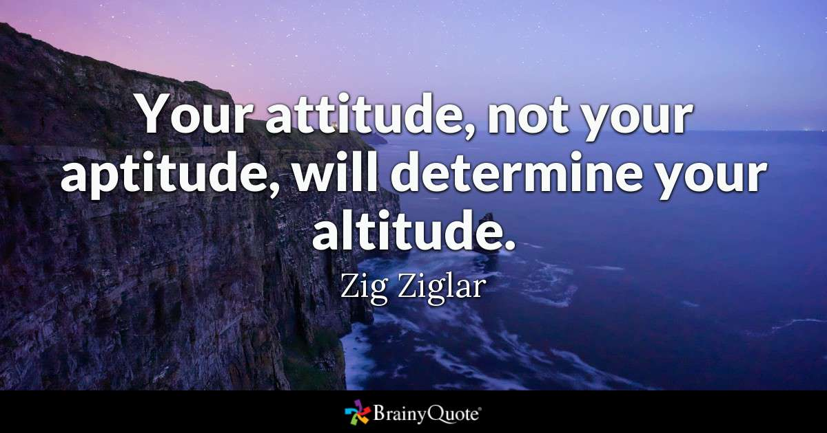


Slide 15
Why Attitudes for Civil Engineers? BOK2
A wealth of study and professional opinion points to the importance of attitude in individual and group achievement.
Teaching of attitudes is an integral part of educational practice.
Attitudes are an integral part of the BOKs of other professions and specialties such as architecture, accounting, and law.

Slide 16
Why Attitudes for Civil Engineers? BOK3
Positive professional attitudes create a more effective and pleasant workplace.
Perceptions of civil engineers may be enhanced by exhibiting positive attitudes, which may also lead to better career opportunities for civil engineers.
Q2. DO YOU THINK OUR ATTITUDE MATTERS? WHY OR WHY NOT?

Slide 17
ATTITUDES Professional Engineering Practice Issues
THEORY

Slide 18
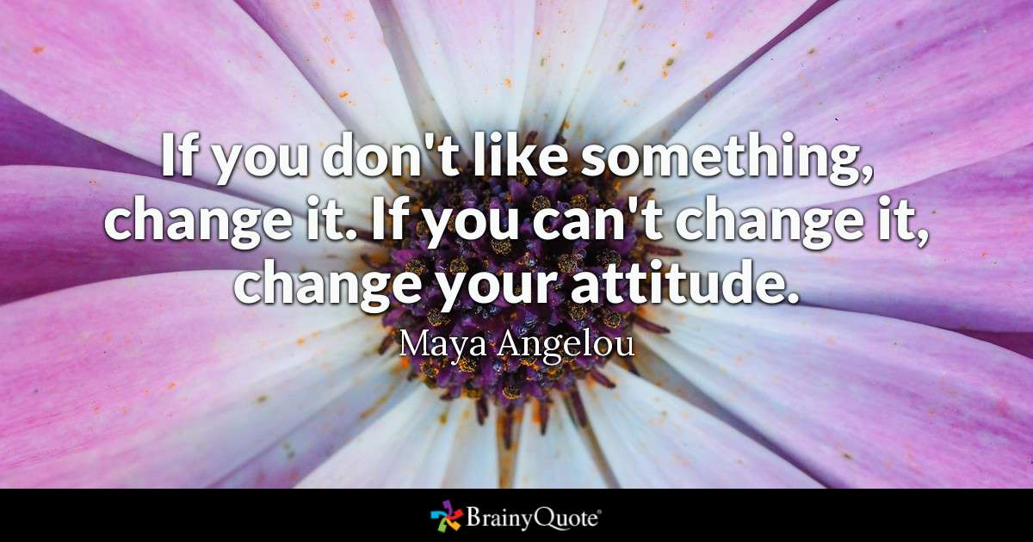
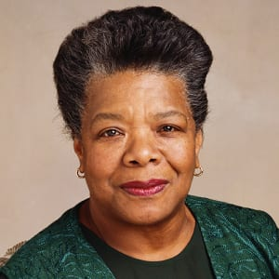

Slide 19
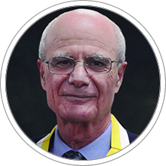
THEORY OF PLANNED BEHAVIOR/ REASONED ACTION
Theory of Reasoned Action suggests that a person's behavior is determined by his/her intention to perform the behavior and that this intention is, in turn, a function of his/her attitude toward the behavior and his/her subjective norm.
ICEK AJZEN

Slide 20
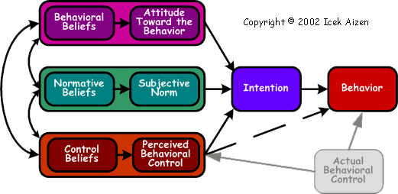
Source: Ajzen, I. (1991). The theory of planned behavior. Organizational Behavior and Human Decision Processes, 50, p. 179-211.

Slide 21
Core Assumptions and Statements Theory of Planned Behavior/ Reasoned Action
The best predictor of behavior is intention. Intention is the cognitive representation of a person's readiness to perform a given behavior, and it is considered to be the immediate antecedent of behavior.
This intention is determined by three things: their attitude toward the specific behavior, their subjective norms and their perceived behavioral control.
The theory of planned behavior holds that only specific attitudes toward the behavior in question can be expected to predict that behavior.
In addition to measuring attitudes toward the behavior, we also need to measure people’s subjective norms – their beliefs about how people they care about will view the behavior in question. To predict someone’s intentions, knowing these beliefs can be as important as knowing the person’s attitudes.
Finally, perceived behavioral control influences intentions. Perceived behavioral control refers to people's perceptions of their ability to perform a given behavior.
These predictors lead to intention. A general rule, the more favorable the attitude and the subjective norm, and the greater the perceived control the stronger should the person’s intention to perform the behavior in question.

Slide 22
ATTITUDES Professional Engineering Practice Issues
WHICH ATTITUDES?

Slide 23
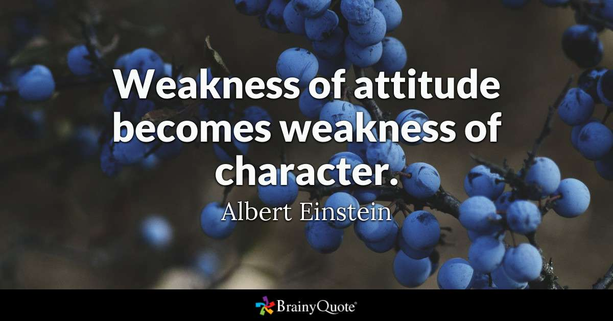
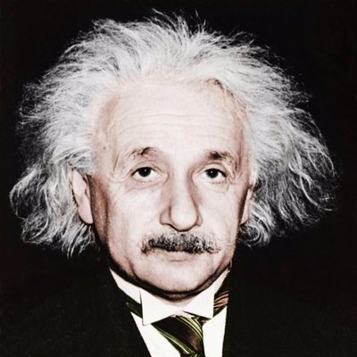

Slide 24
Attitudes that support the effective practice of civil engineering… BOK2
An exhaustive list of appropriate attitudes would be difficult to compile. A partial list …might include:
Commitment
Confidence
Consideration of Others
Curiosity
Fairness
High Expectations
Honesty
Integrity
Intuition
Good Judgment
Optimism
Persistence
Positiveness
Respect
Self-esteem
Sensitivity
Thoughtfulness
Thoroughness
Tolerance

Slide 25
Attitudes that support the effective practice of civil engineering… BOK3
Professional attitudes encompass a range of elements including
Other professional attitudes …may include
Creativity
Curiosity
Flexibility
Dependability
Commitment
Confidence
Empathy
Entrepreneurship
Fairness
Honesty
Integrity
Optimism
Persistence
Respect

Slide 26
Key Professional Attitudes… BOK3
Creativity… is the ability to make new things or form new ideas and is needed to solve complex civil engineering problems that do not have obvious solutions
Curiosity… is the urge to know about something and is essential for the civil engineer to gain new knowledge and to be more creative
Flexibility… is the ability to change or be changed according to the situation and is critical for civil engineers to work within a diverse group and in an ever changing environment
Dependability… is defined as the quality of being able to be counted on or relied upon and is an attitude civil engineers should display

Slide 27
ATTITUDES Professional Engineering Practice Issues
LEARNING EXERCISE

Slide 28
Key Professional Attitudes… BOK3
Creativity…
Curiosity…
Flexibility…
Dependability…

Slide 29

Application 3.2 Explore the professional attitudes of creativity, curiosity, flexibility, dependability
Attending the WCOE Job Fair on FEBRUARY 16?
Consider….
What positive professional attitudes do you hold?
How might you communicate these to a prospective employer?
Can you think of examples? Illustrations?

Slide 30
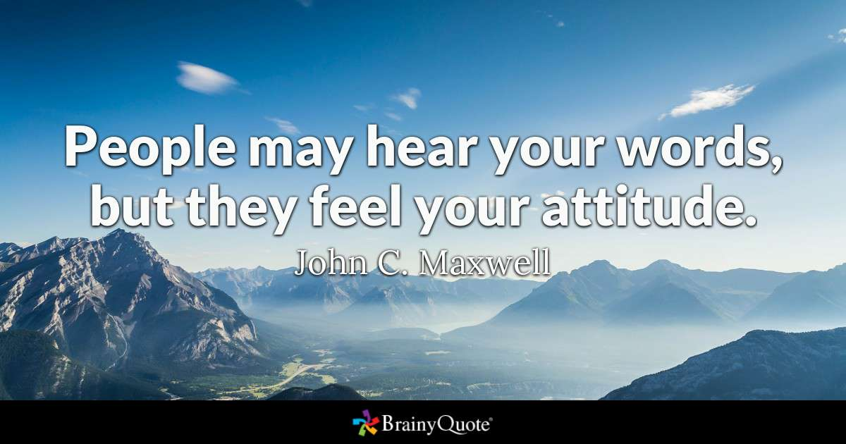


Slide 31
ATTITUDES Professional Engineering Practice Issues
SUMMARY

Slide 32
CE 4200 Professional Engineering Practice Issues
QUESTIONS?

